Slide 1
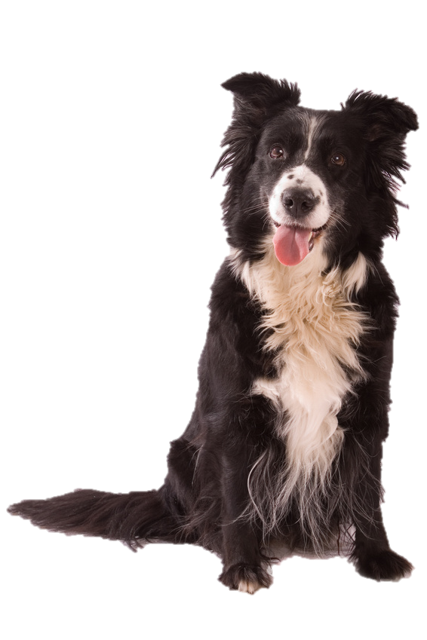
Kizzy Ann Stamps
Costs and Benefits Lesson

Slide 2
Notes:
Book Synopsis: Kizzy is a ‘tell the truth’ kind of girl. Her favorite thing to do is spending time outside with her border collie, Shag. She certainly does not consider herself to be a ‘frilly bow type of girl’. However, when Kizzy’s mother asked for hand-me-down dresses from Laura Westover’s mother before school started; Kizzy wore the white frilly dress on her first day of school as to not disappoint her mother. The cost of disappointing her mother on such an important day outweighed the benefit of being disagreeable.
Cost/Benefit Analysis
Introduction: Kizzy Ann Stamps is full of decision making moments. Some decisions involved much thought as when Kizzy decided to enter Shag into the dog show. Yet, other decisions were made quickly with not much contemplation such as when Kizzy ran to help Mrs. Feagans when she was experiencing a seizure.
Did Kizzy use any decision making tools? One decision making tool is a Cost-Benefit Analysis which involves identifying the costs and benefits of specific choices, including the consequences, both intended and unintended, of the decisions and how people responded to positive and negative incentives.

Slide 3
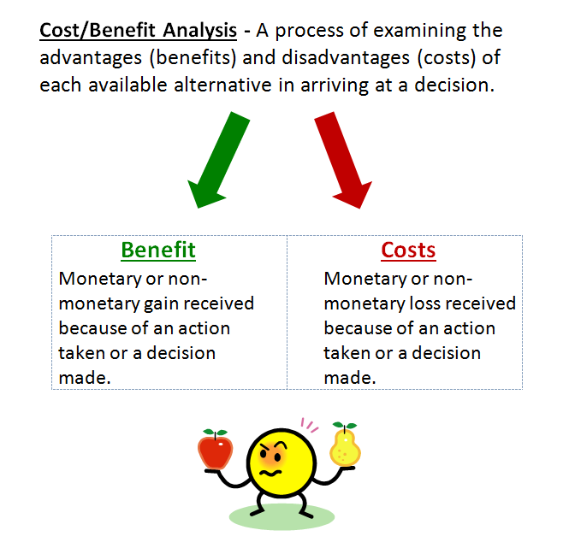

Slide 4
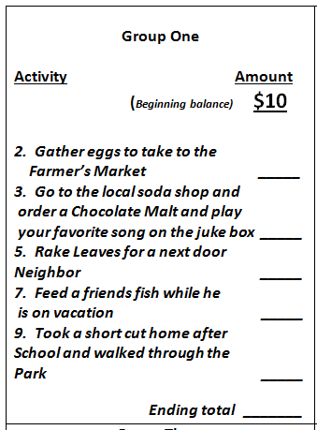

Slide 5
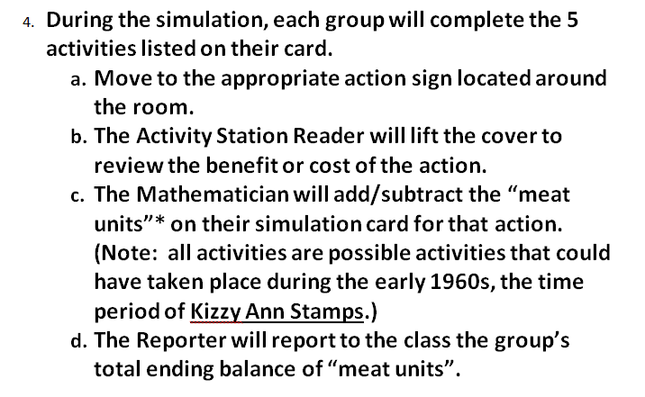
Notes:
* Money is a tool to use to obtain the things that we want. One must work to earn money to buy the things that we want. On Saturday mornings, Kizzy would go with her Granny Bits to the market in Bedford City to sell fresh produce. Also, at times neighbors would visit Kizzy’s home to purchase fresh corn from Granny Bits. One afternoon, Kizzy was upset that her granny would sell produce to the Feagans family, because they caused her family so much hardship. Granny Bits said “pride never put meat on the table.” Therefore, in this simulation we will use units of meat to represent benefits and costs

Slide 6
Consequences
Intended
Unintended
Notes:
8. Discuss each activity station and the cost/benefit of the station. When discussing, make mention the consequence of the action. Sometimes consequences are intended, however; at times consequences can be unintended. Which activity station involved an unintended consequence? (# 6 – broke window while playing catch, #9 – tearing clothes while climbing a tree in the park)

Slide 8
